Slide 1


E- Ration Shop
INSTITUTE FOR ADVANCED COMPUTING AND SOFTWARE DEVELOPMENT AKURDI, PUNE
Project Guide
Mr. Akshay Parab
Group No-88
Group Member
Rohit Auti (2020)
Rahul Bhagat (2023)

Slide 2
Introduction
Digital platform to allows consumers to directly buy goods or services from a seller over the internet using a web browser and get home delivery
Provide complete solutions for vendors, supplier as well as customers through a single get way using the internet
Online customers must have access to the Internet and a valid method of payment in order to complete a transaction
Features:-
Avoiding overcrowding
keep yourself safe
avoid queues.
reduces waiting time

Slide 3
Modules
List of Module
Admin
1. Admin can see all Details of supplier, orders, customers etc
2. Admin can add new supplier
3. admin can add new delivery boy
Supplier
1. Supplier can see /update all details of products
2. supplier can add new product
3. Supplier can update profile details
Customer
1. Customer can create/login account
2. Customer can update profile details
3. Customer can search product.
4. Customer can edit/update Cart
5. Customer can place order and make payment
Delivery Boy

Slide 4
Modules
List of Module
Customer
1. Customer can create/login account
2. Customer can update profile details
3. Customer can search product.
4. Customer can edit/update Cart
5. Customer can place order and make payment
Delivery Boy
1. Delivery Boy can update profile
2. Delivery Boy update Order status

Slide 5

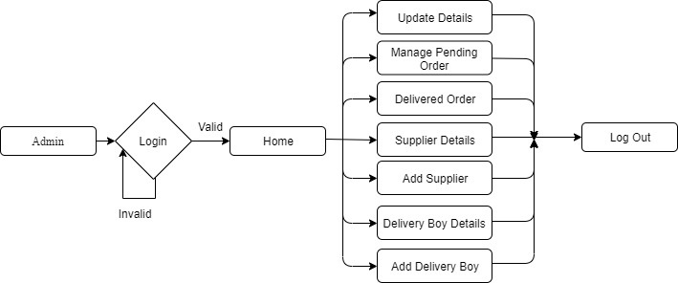
Data Flow Diagram
Level 0 -DFD
Level 1 -DFD

Slide 6
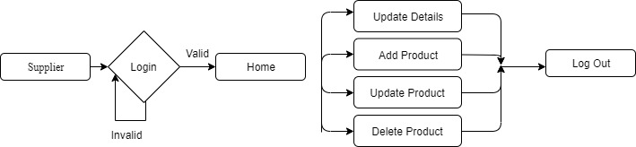
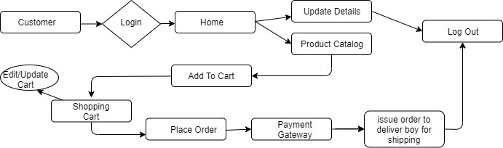
Data Flow Diagram
Level 1 –DFD Supplier
Level 1 –DFD Customer

Slide 7
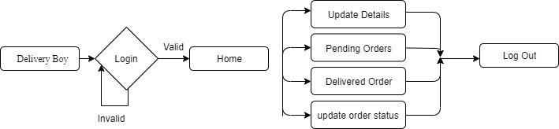
Data Flow Diagram
Level 1 –DFD Deliver Boy

Slide 8
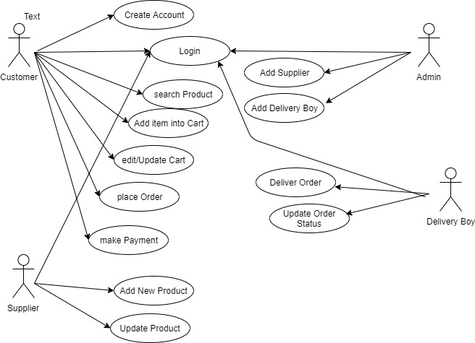
Use Case Diagram

Slide 9
Technology Used
Front End:
css and html in front end as react
Front End:
Java 1.8
spring mvc FrameWork
Database
MySql 8.0.21

Slide 10
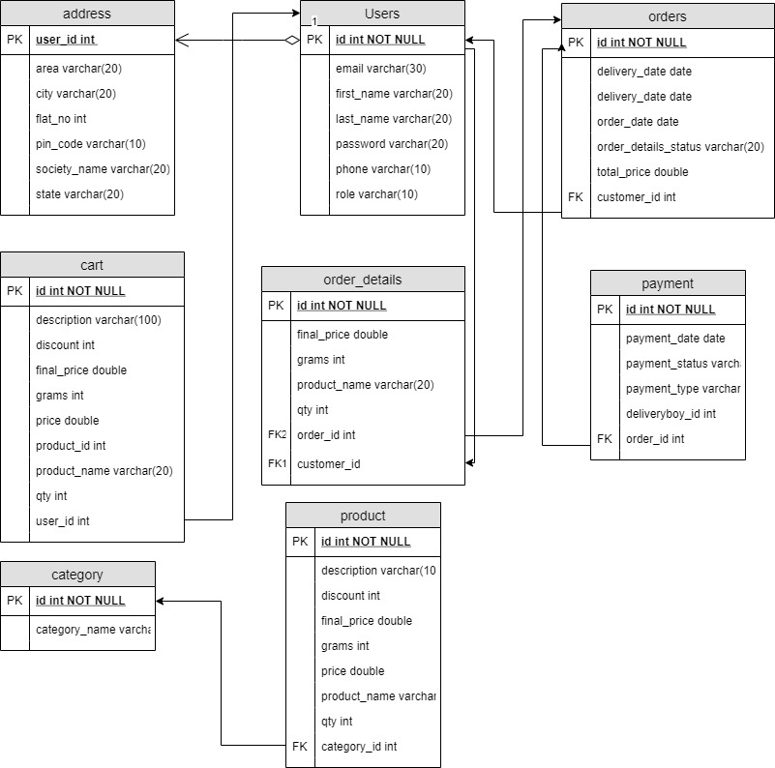
E-R Diagram

Slide 11
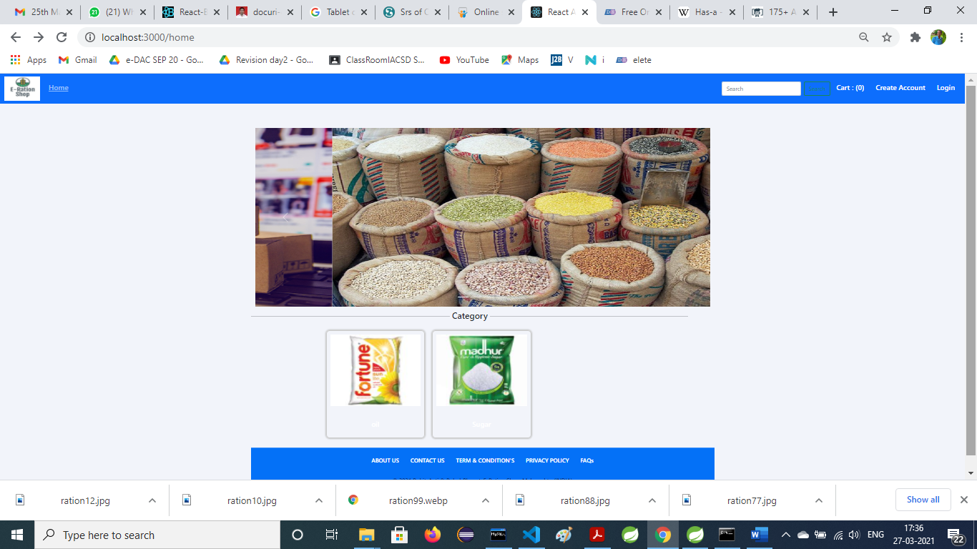
GUI

Slide 12
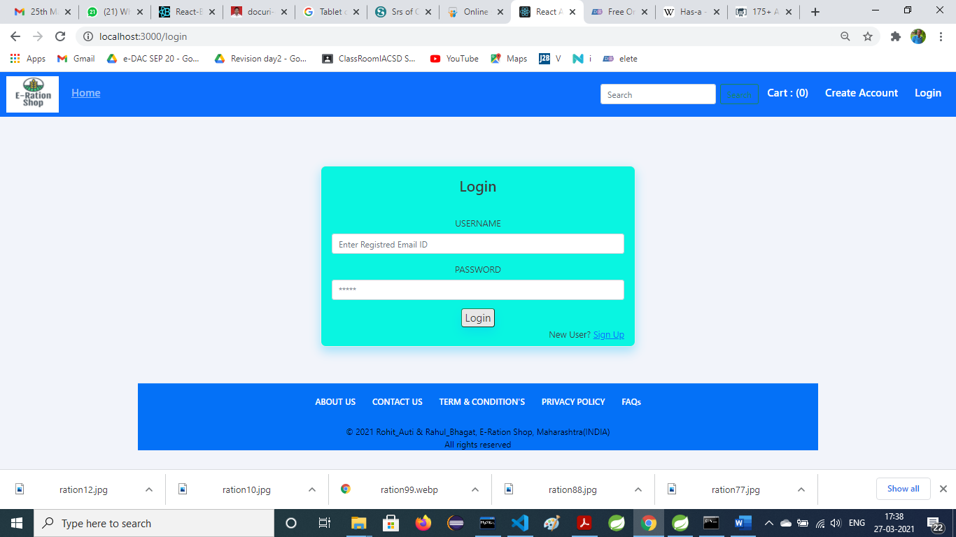
Login Page

Slide 13
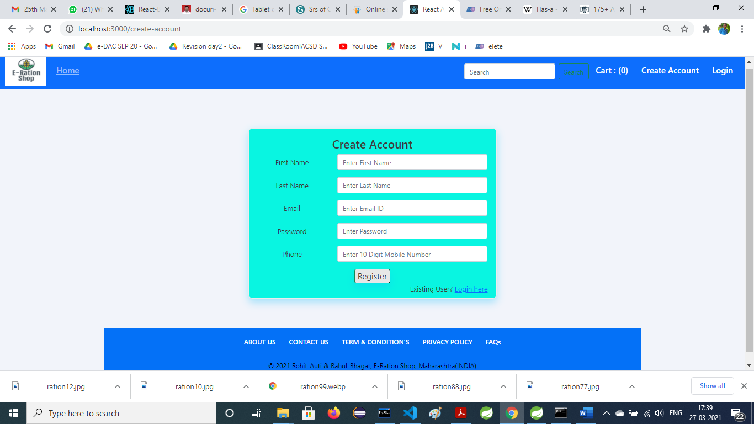
Registration Page

Slide 14
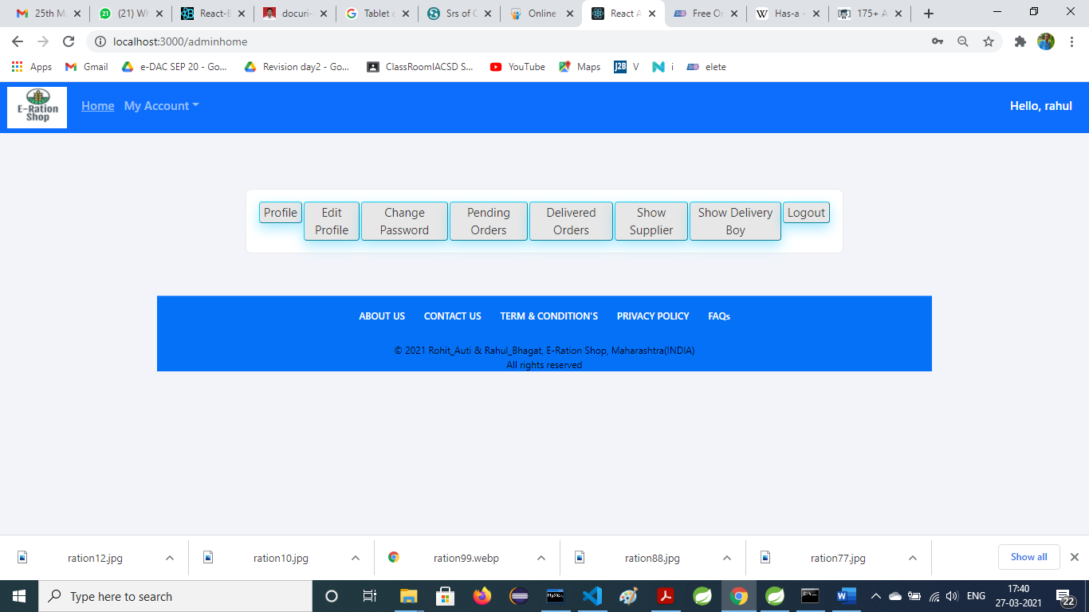
Admin Home Page

Slide 15
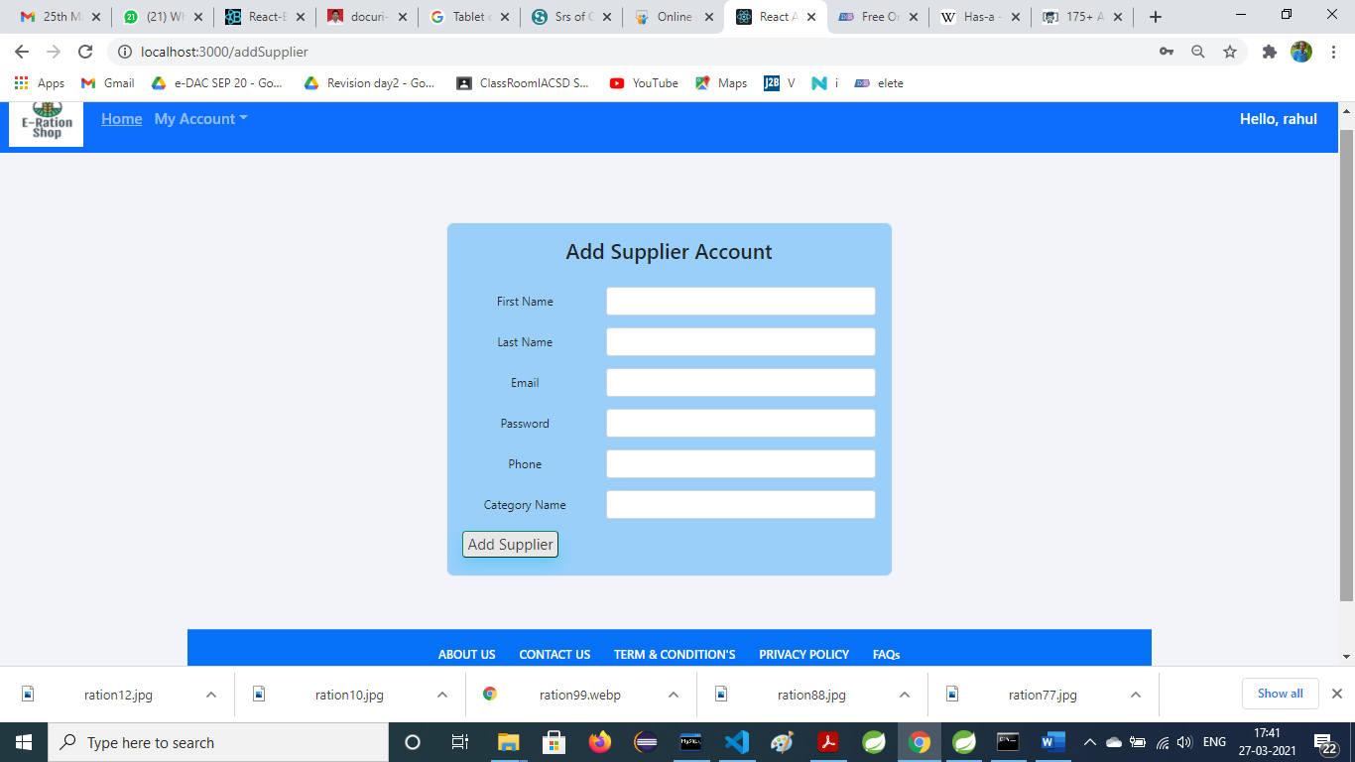
Add New Supplier

Slide 16
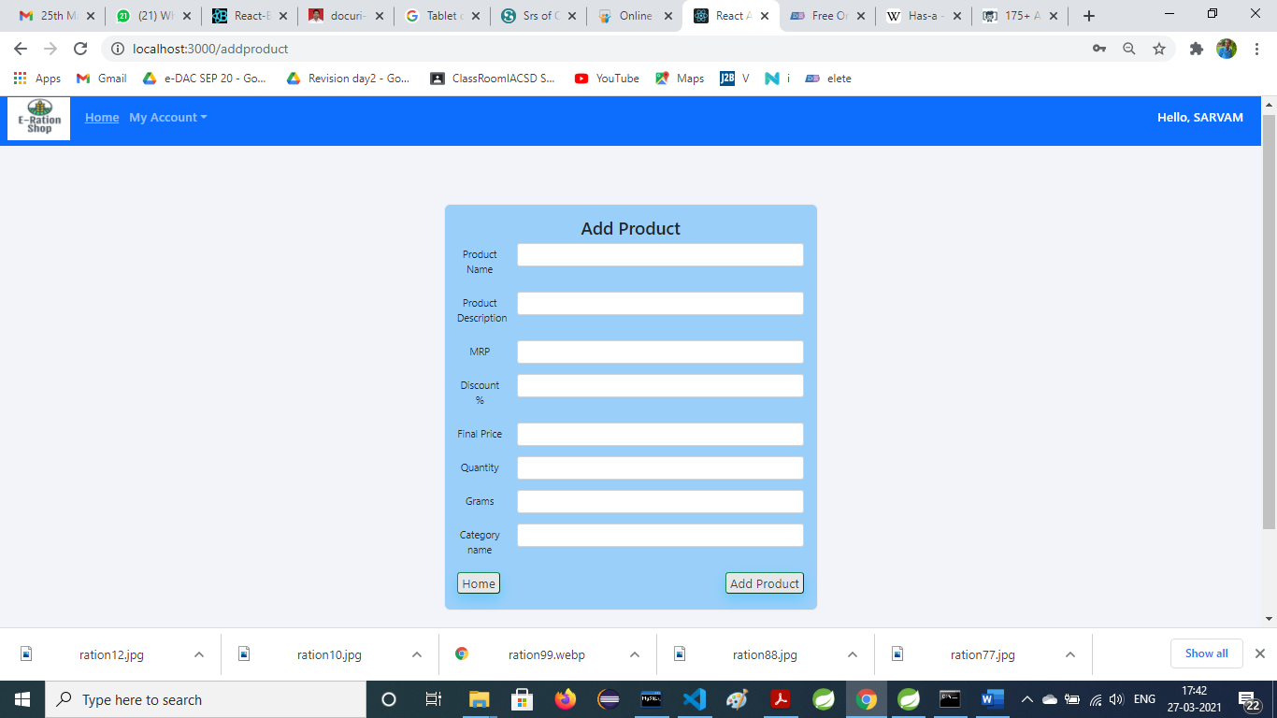
Add New Product

Slide 17
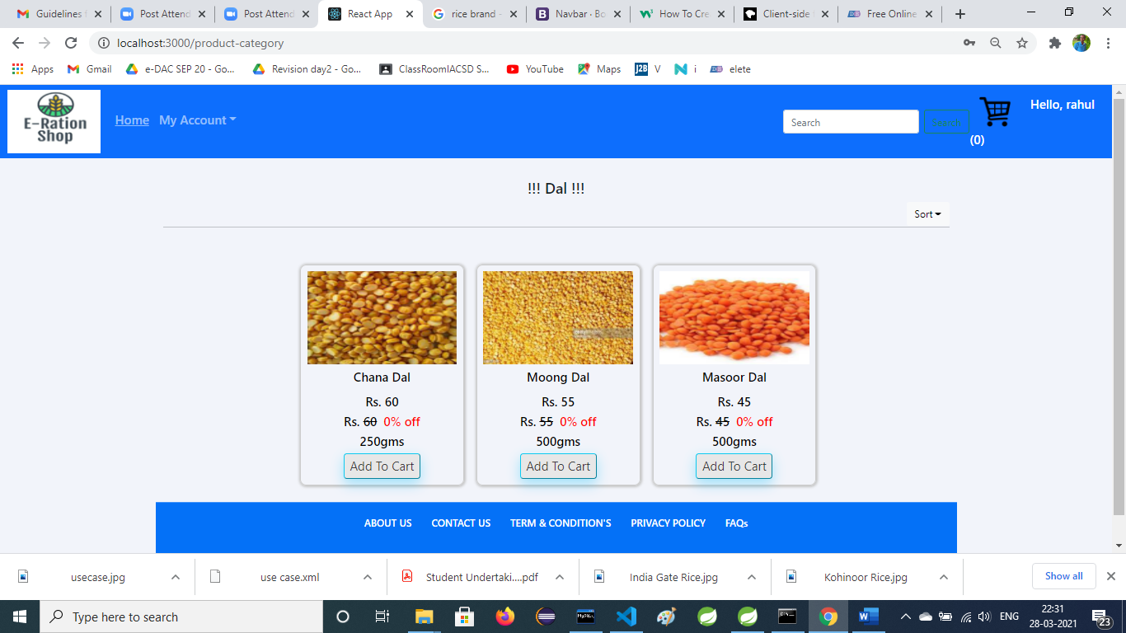
Product

Slide 18
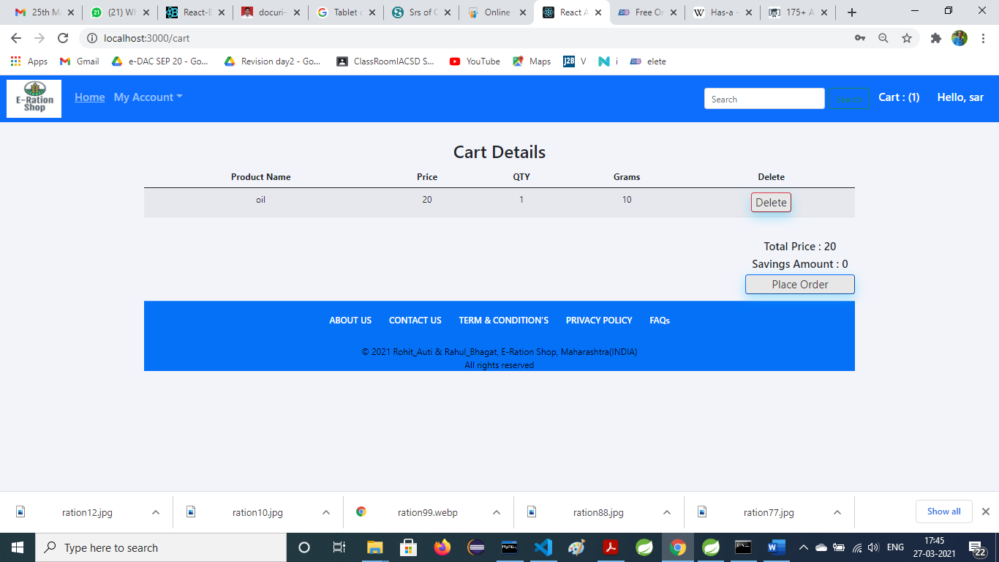
Cart Details Page

Slide 19
Scope
This system can be implemented to any shop in the locality or to multinational branded shops having retail outlet chains.
The system recommends a facility to accept the orders 24*7 and a home delivery system which can make customers happy.
Shops providing online portal where their customers can enjoy easy shopping from anywhere, the shops won’t be losing any more customers to the trending online shops.
Since the application is available in the internet it is easily accessible and always available.

Slide 20
Conclusion
E-Ration Shop is developed with the help of different tools such as React, HTML, CSS, Bootstrap, JavaScript, Spring MVC and MYSQL . The developed system has met the objectives.
It is an user friendly application and promotes user to purchase and shop faster With new technology comes better way of doing things
Being able to buy anytime anywhere and home delivery you don’t have to travel to shop

Slide 21
References
https://reactjs.org/docs/getting-started.html
https://getbootstrap.com/docs/5.0/getting-started/introduction/
https://nodejs.org/en/docs/
https://spring.io/guides/gs/sts/
https://www.practicalecommerce.com/cart_intro

